Slide 1



Palate Cleanser
googly????

Slide 2





Fanfiction Classifier
Waverly Wang

Slide 3

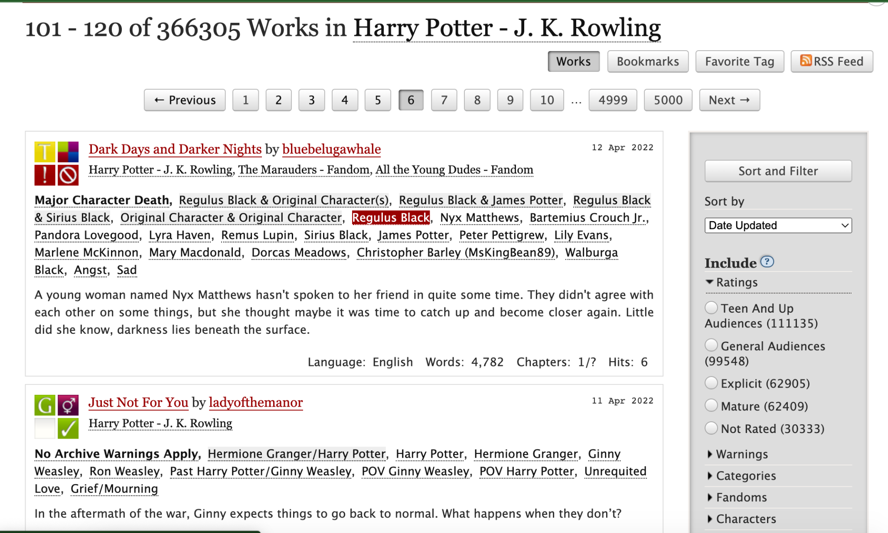


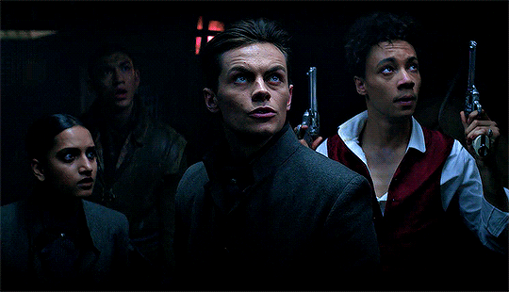

Motivation:
I like fanfiction. Specifically from Archive of Our Own.

Slide 4
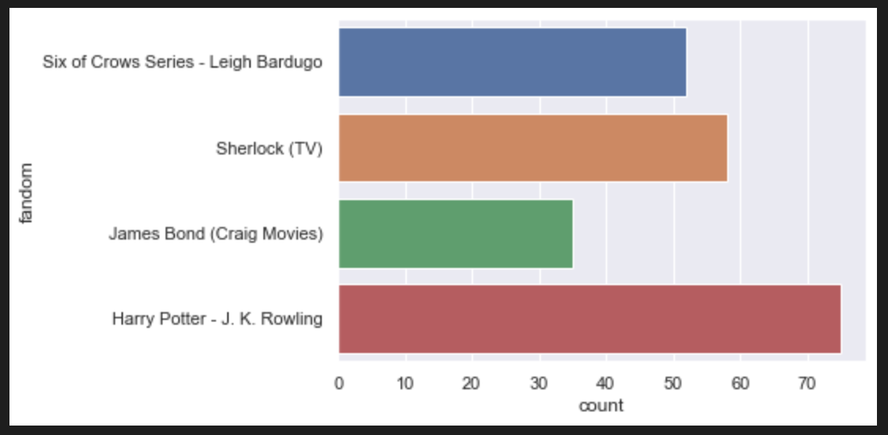
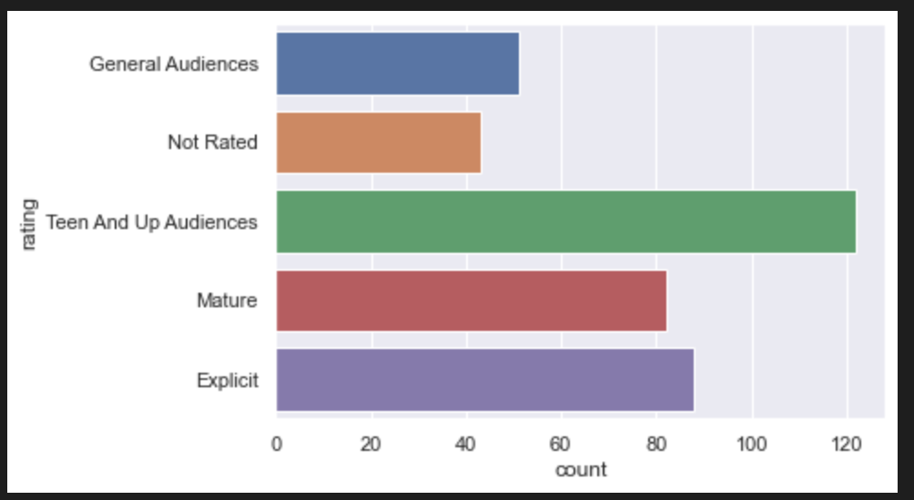
How does predicting rating of fanfic compare to predicting fandoms?
What is the best classifier?
Comparing using TF-IDF Vectors as features and Knn, RF model for classifying Vs. BERT classification

Slide 5


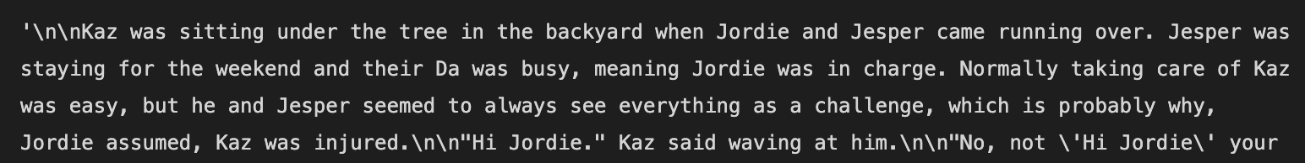

Workflow
Scraping Data
Cleaning Data
Text to Feature
Create a Model
Libraries!
Numpy, Pandas for storing data
Pickle for storing the models
Nltk for cleaning, Sklearn for TFID feature extraction
Matplotlib, seaborn for visualizing data
Tensorflow, BERT
Google colab
Resources:
Ao3 Python Scraper
Miguel Zafra - newspaper classifier to classify genres on github which I used.
Amal Nair - Bert newspaper classifier

Slide 6
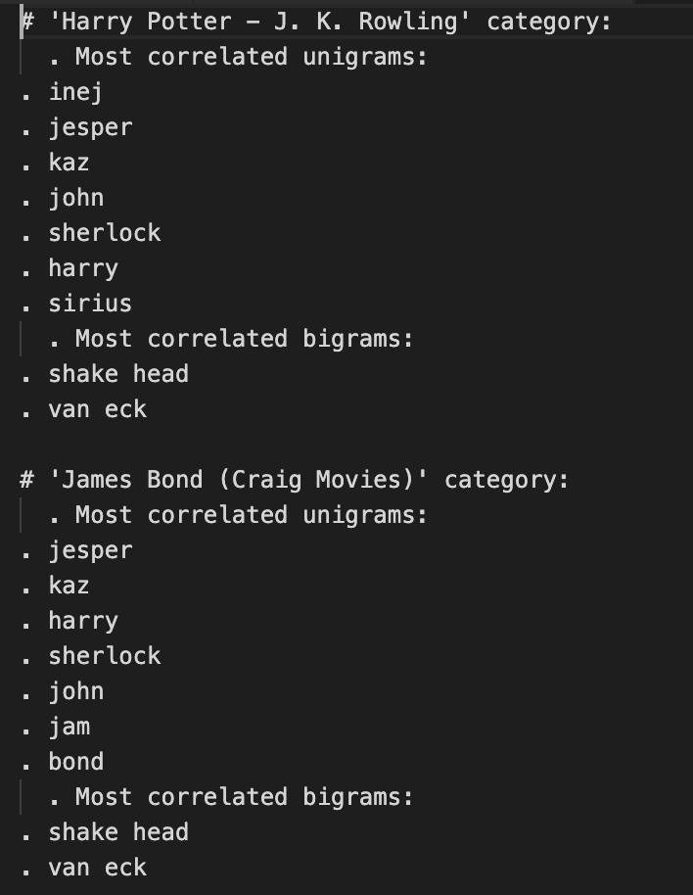
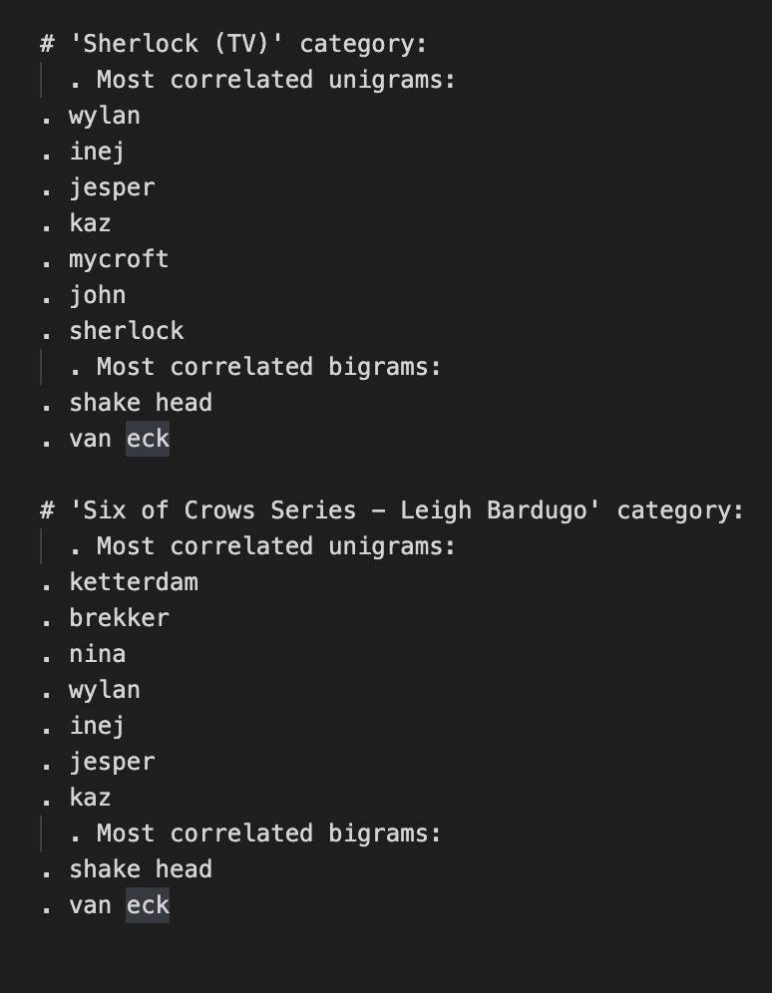
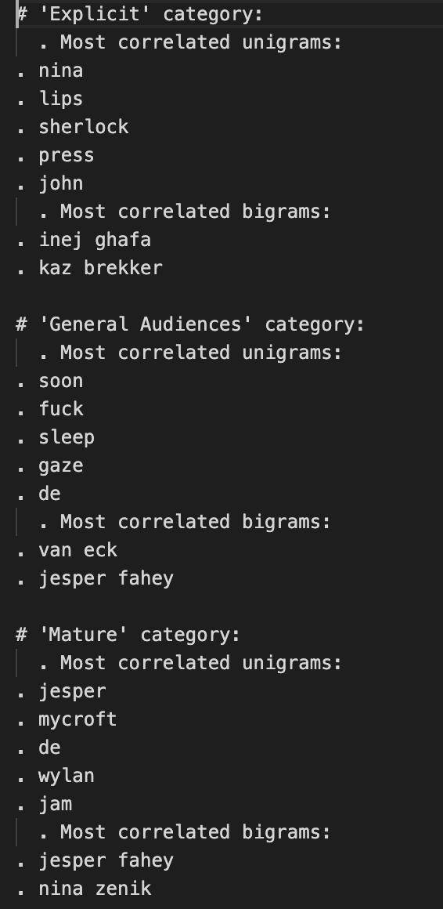
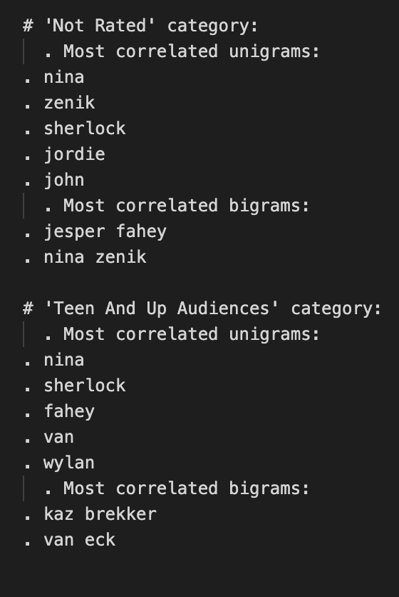
DEMO
Using TFID created 300 features from the fanfiction texts and found most correlated unigrams
FANDOM (220 fics only 4 fandoms) vs. RATING (348 fics with multifandom)
These are the right characters!
???
All correct
Character names???
Notes:
Convert text to word frequency vectors,
TF-IDF representation attempts to highlight important words which appear frequently in a document but not across documents. The terms are briefly explained below:
Term Frequency (TF): This summarizes the normalized Term Frequency within a document.
Inverse Document Frequency (IDF): This reduces the weight of terms that appear a lot across documents.

Slide 7
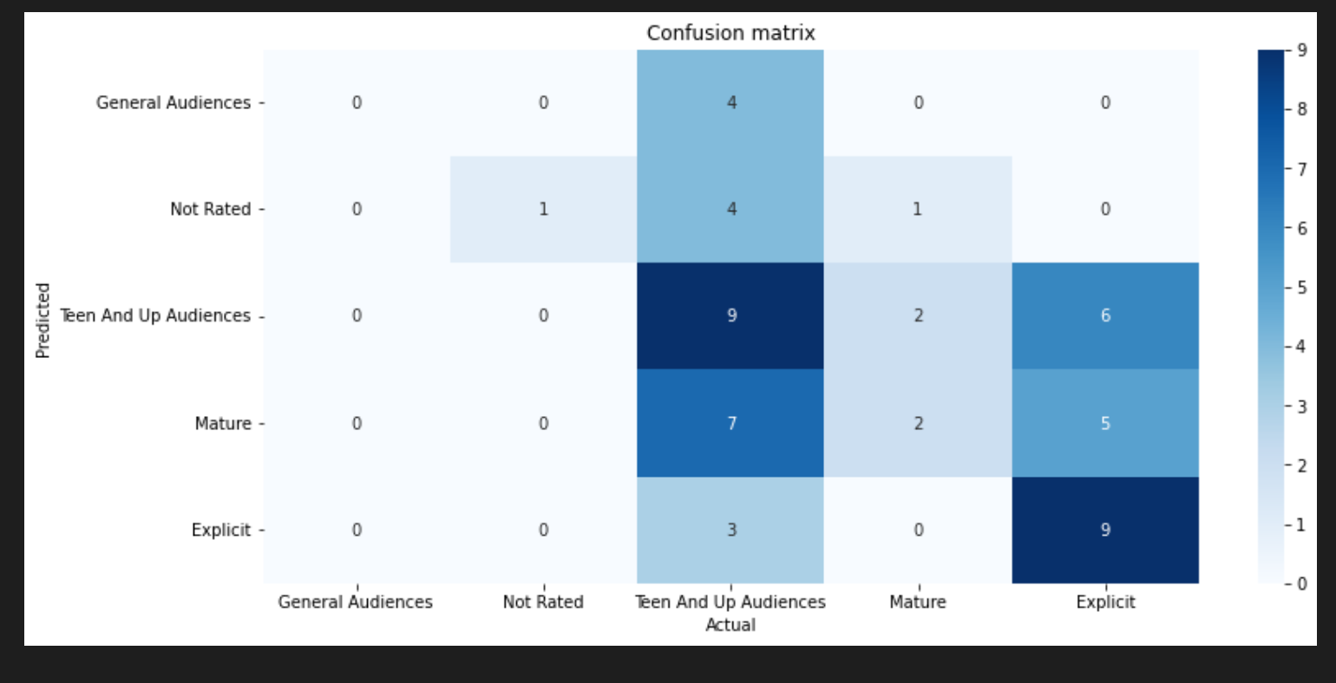
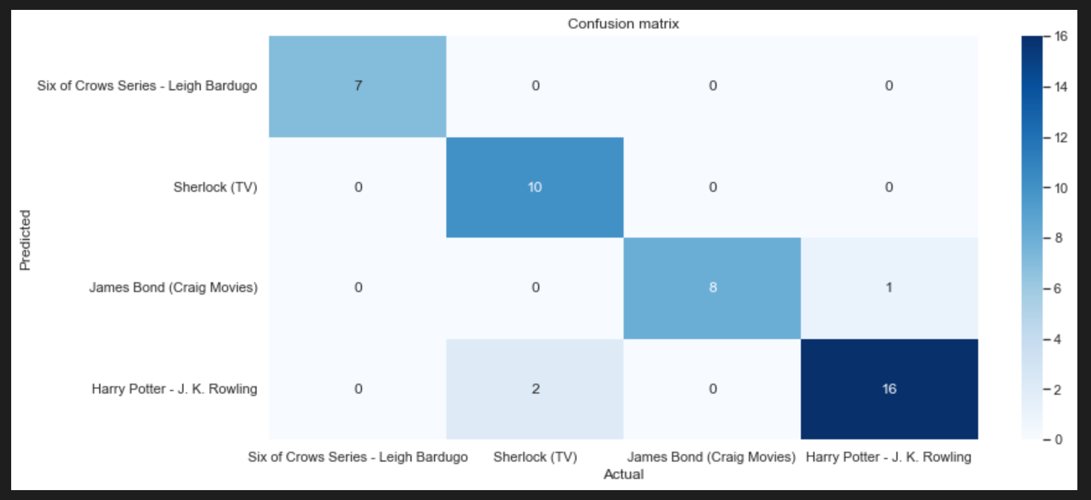
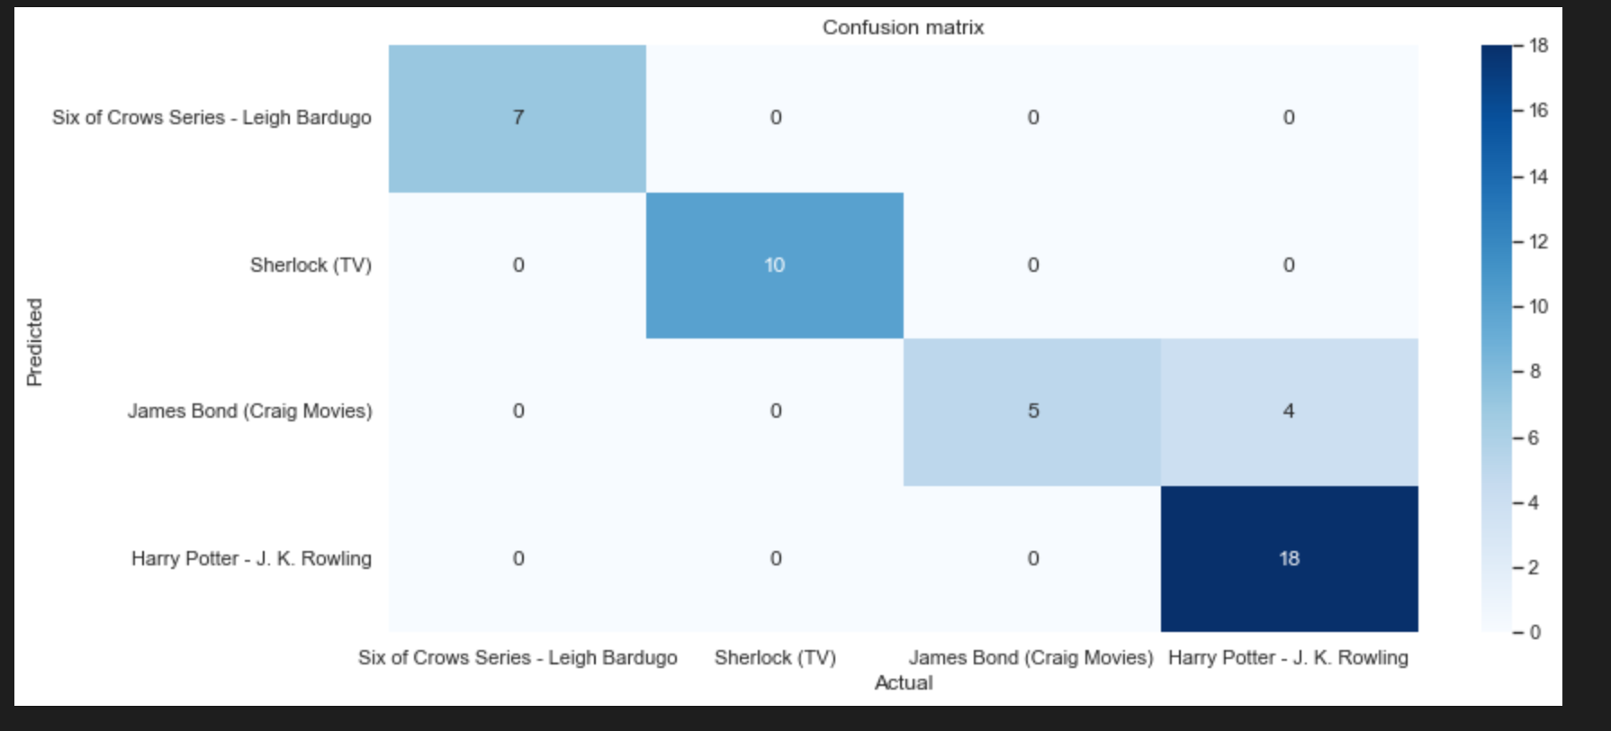
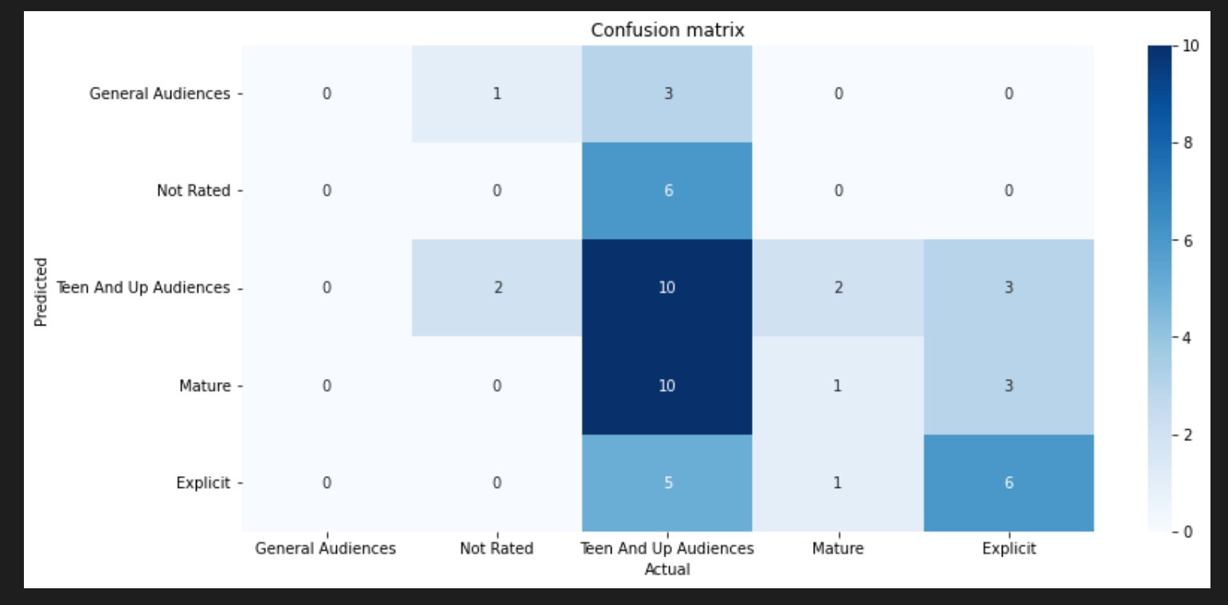
Fandom vs. Rating
Knn
Training Set Accuracy: .433898
Test Set Accuracy 0.396226
Knn
Training Set Accuracy: 1.0
Test Set Accuracy .931818
Better than guessing!
But pretty bad
RF
Model: Training Set accuracy: 1
Test Set Accuracy: .320755
RF
Training Set Accuracy: .994318
Test Set accuracy: .909091
Later,
Tried with more data 500 fics and it did worse… like 20% …. :(

Slide 8

Reflection
I feel like people don’t rate their own fics the same way. What’s smutty for other people is tame for others.

Slide 9

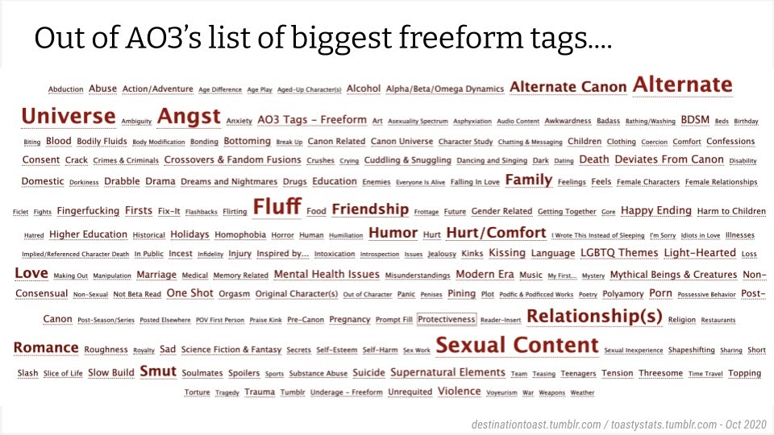
What next?
Improve the rating classifier.
I feel like tags are
the key.
Also I need way more
fics

Slide 10
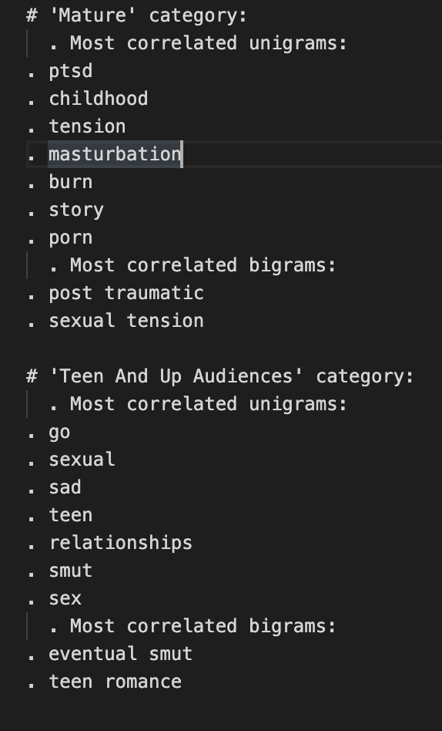
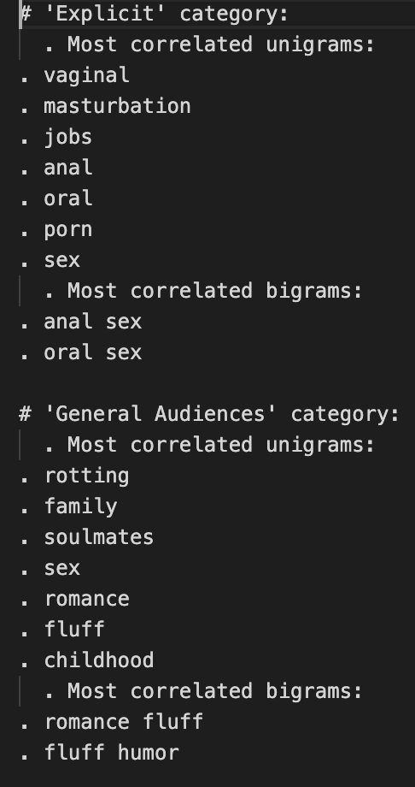
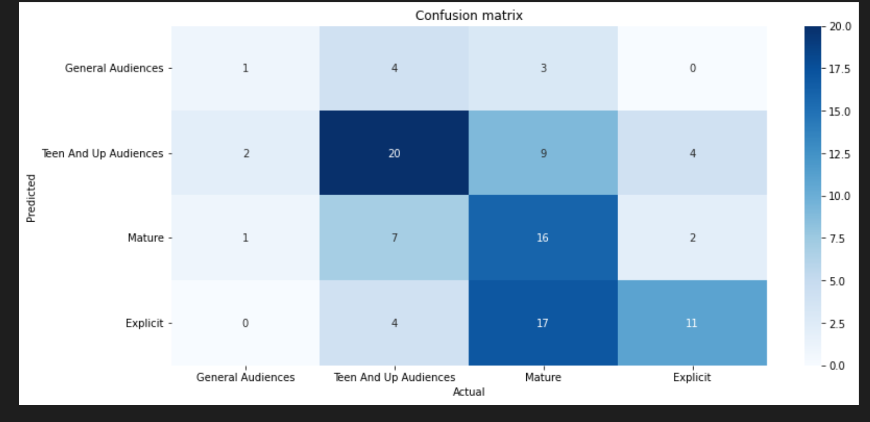
Result: improved a little (using 500 multifandom fics dataset) (I took out Not Rated fics)
KNN
Training Set .596535
Test Set .475248
NSFW
NSFW
NSFW
Scandalous! But seems correct!
???
Seems teen like
wholesome!
???
RF usually does worse so I just skipped that…

Slide 11
Next? Try BERT

Slide 12
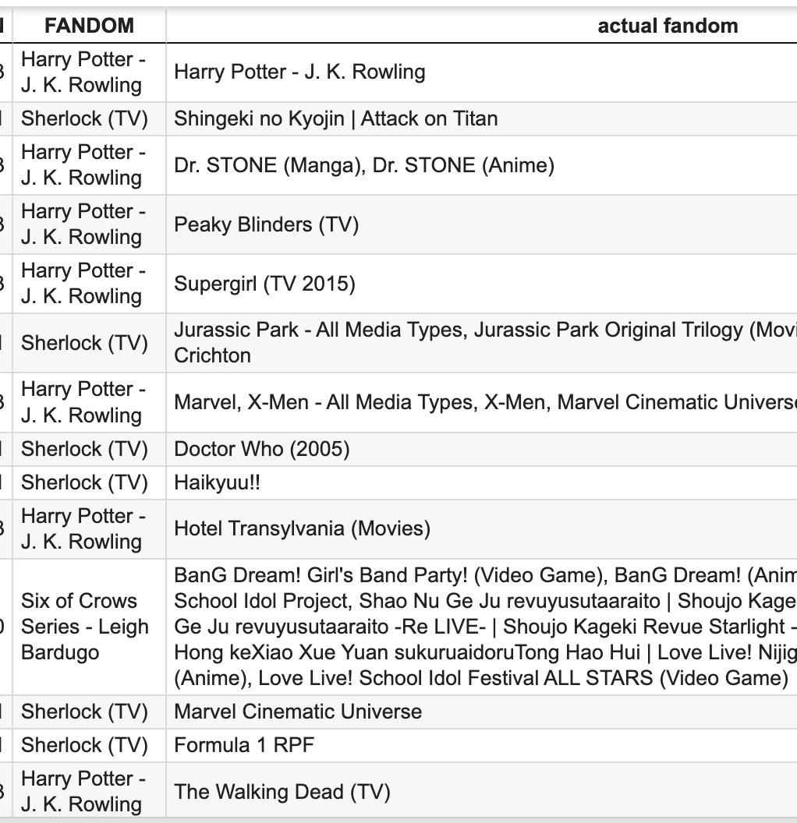
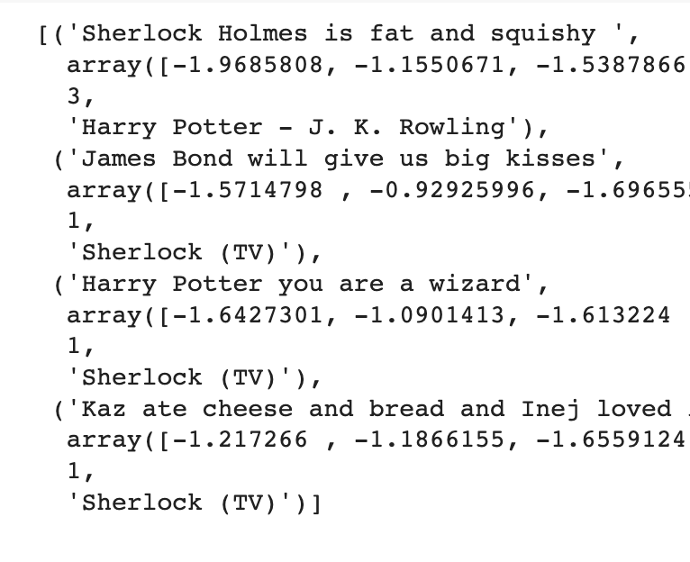
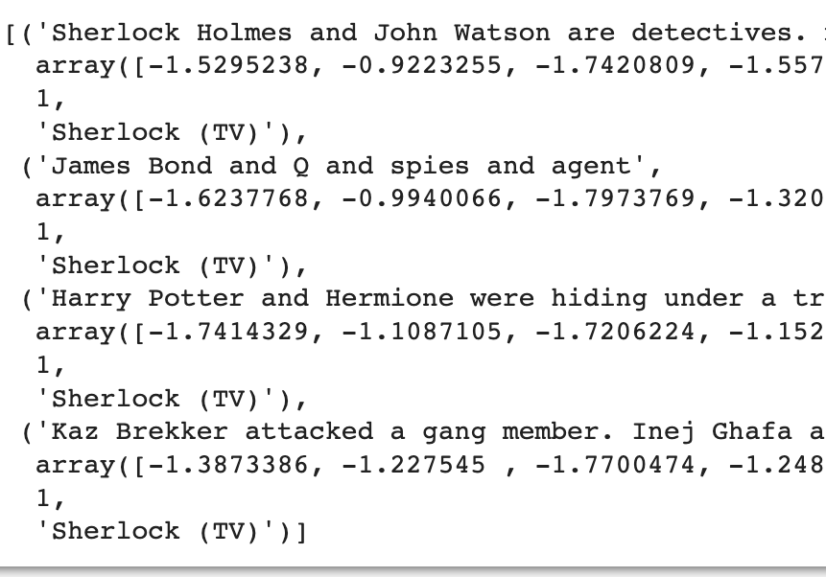
Fandom Classifying with BERT results
Tried a Test set…but with fandoms other than the 4 it was trained on. Interesting results
68% evaluation accuracy
with 512 tokens, 3 Epochs
34% with a test set with 4 fandoms (151 fanfics)
Random tests below - One sentence fanfiction predicted! With interesting results….
It got one right
Supergirl is most like Harry Potter??
Doctor Who is similar to Sherlock…plausible
The walking dead is like harry potter?
Notes:
The BERT algorithm is built on top of breakthrough techniques such as seq2seq (sequence-to-sequence) models and transformers. The seq2seq model is a network that converts a given sequence of words into a different sequence and is capable of relating the words that seem more important.
https://towardsdatascience.com/building-a-multi-label-text-classifier-using-bert-and-tensorflow-f188e0ecdc5d
Bidirectional Encoder Representations from Transformers. However, unlike these previous models, BERT is the first deeply bidirectional, unsupervised language representation, pre-trained using only a plain text corpus (Wikipedia).
Bert is bidirectional contextual model of text. In unidirectional contextual model, words would be based off only the other words before it. So for each word it will generate a representation based off of both words before and after it.
Good News: Google has uploaded BERT to TensorFlow Hub which means we can directly use the pre-trained models for our NLP problems be it text classification or sentence similarity etc.

Slide 13
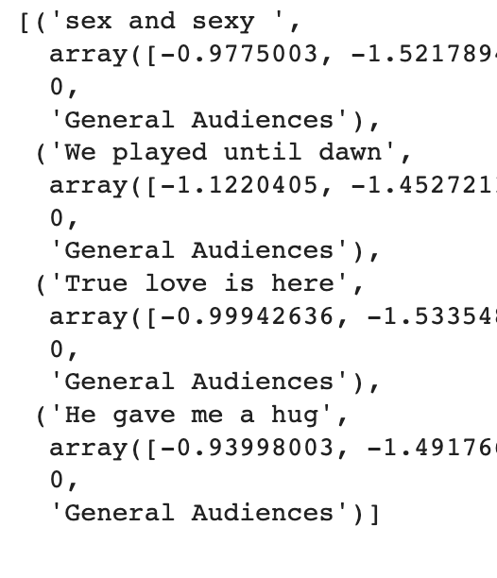
Rating Classifying with BERT results
34% evaluation accuracy
with 512 tokens, 3 Epochs, 1.2 loss
18% on the outside test set
Made a predictor, put in sentences, classified badly
I don’t think sex and sexy is general audiences >:(

Slide 14
What’s Next?
Play around with BERT more to improve the classifiers. Maybe use tags? Try other classification models?
Make a website?

